Slide 1
Introduction to Data Analytics: Visual Thinking
Ian Nabney
ian.nabney@bristol.ac.uk

Slide 2
Overview
Getting information: visual space and time
Understand the psychological basis of the connections between perception and action
Able to apply appropriate choices to design challenges

Slide 3
Visual space
Moving our eyes is the lowest-cost method we have for getting additional information about our environment. It has such a low cognitive cost that we are not even aware that we are making eye movements several times a second.
Eye movements, rummaging through filing cabinets, and business travel are ultimately all methods for traversing space to get information into our working memory systems, though they differ enormously in efficiency.
The cognitive organism acts on visual information that is imaged on the retina.
The perceptual egocentric space is commonly thought of in terms of the up dimension, the sideways dimension, and the towards-away dimension.
Because we get just one pixel of information in the towards-away dimension, we rely on (contextual) visual cues for a sense of depth.

Slide 4
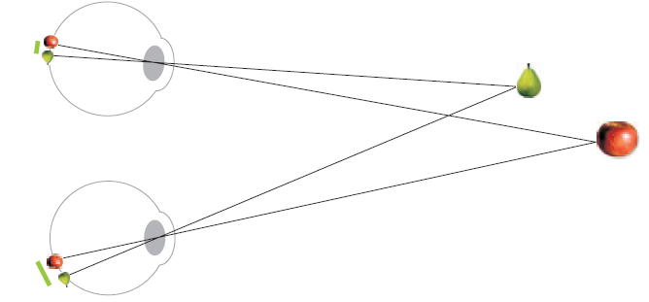

Visual cues
Depth cues can be pictorial or non-pictorial
Pictorial depth cues can be reproduced in a photograph and include occlusion, geometry (size and texture gradients, linear perspective, shadows, depth of focus, etc.
Non-pictorial depth cues are stereopsis and structure from motion.
Occlusion. In an interactive system, occluded information can be brought forward with a mouse click.
Stereoscopic vision is optimal for visually guiding our hands as we reach for nearby objects. It works best in making judgements of the relative distances of nearby objects, within a metre or two of our heads.

Slide 5
2.5D Design
The key idea in 2.5-dimensional design is to treat depth in the picture plane very differently from the other two dimensions. Most relevant to infographics: https://neomam.com/interactive/13reasons/
  Depth cues should be used selectively to support design goals. They do not have to be realistic.
  Objects should be laid out with minimum occlusion: transparency can help.
  Make clear spatial relationships, such as on top of, attached to, and inside of.
  Display text in the image plane: text that is slanted for perspective is hard to read.
Attempts to show abstract non-spatial data using three-dimensional views have not been successful mostly because the information is not displayed clearly and because getting around in three dimensions is much harder than in two dimensions.
The cost of getting a good viewpoint in three dimensions is almost always higher than clicking to follow a hypertext link or zooming in two dimensions. This makes visual queries expensive and slows down the cognitive process.
“Adding pictures of brain scans and mentioning cognitive neuroscience make people more inclined to believe what they are reading.”

Slide 6
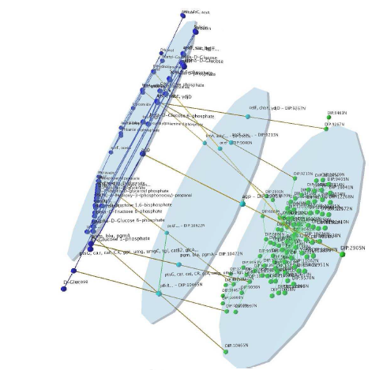
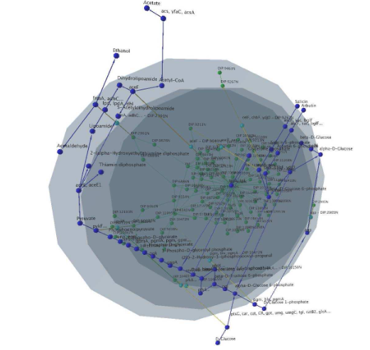
2.5D Information visualisation
Two overlapping networks representing a metabolic network (glycolysis) and a corresponding part of a protein interaction network. The given layout of the metabolic pathway, nodes in blue, is clearly visible. The protein interaction network and inter-plane edges are drawn with a variation of a force-directed method.

Slide 7
Affordances
Gibson claimed that we perceive physical affordances for actions, and not images on the retina, which had been the basis of prior theories.
A flattish ground surface affords passage.
In practice, most useful affordances have to do with access to information.
Cognitive affordances are readily perceived possibilities for action. A GUI may have a number of on-screen buttons that are available for metaphorically pressing with the mouse cursor.
Affordances are ultimately about linking perception and action, and there are pathways in the brain that are specialized for this task.
The where pathway runs forward from V1 and V2 to the parietal lobe in the middle of the upper part of the brain. The parietal lobe contains a number of coarse action maps of visual space.
There are maps with retinal coordinates, body coordinates, and external world coordinates. Each map links visual information to some form of guided movement.

Slide 8
Visual maps
These visual maps are temporary and have very little detail.
The eye-space map is updated every time we move our eyes. It contains a rough representation of the locations of a few objects in space that are task-relevant.
Much of what goes on in the where pathway is unconscious. Most of the time, we are completely unaware that we are making eye movements. We are also unaware of the hand movements we make in grasping moving things.
Efficient designs for information access generally build on visual motor skills we already possess. For example, although a computer mouse is completely disconnected from the cursor on the screen, the cursor moves to the right when we move our hand to the right.
Human perception is, over time, becoming less grounded in real-world interactions.

Slide 9
Costs of information access
Basic (approximate) costs
Internal pattern comparison | 0.04s | Occurs whenever our eyes fix
Eye movements | 0.1s | Tightly coupled with visual cognitive system
Mouse hover | 1.0s | Mouse pause over an object
Mouse select | 1.5s | Mouse selection of a link
Zooming | Seconds | Most efficient way of traversing large distances with visual continuity
Non-metaphoric navigation is causing such radical changes in the cost of navigating information spaces that human society is being altered:
  Zooming: https://aeon.co/videos/the-classic-1977-film-that-put-the-vastness-of-the-universe-into-perspective
  The click of a mouse button on a hyperlink causes a new screen of information, sometimes from across the world, to appear in less than a second

Slide 10
Visual working memory
Scenes and objects have meaning largely through links to other kinds of information stored in a variety of specialized regions of the brain. This information includes action patterns, eye-movement scanning strategies, and semantic content stored in the language systems of the brain.
These links become activated through the operation of high-level attention-guiding mechanisms that are called working memories. Can store three chunks of information
Information is only held in working memory from between one-tenth of a second and, at most, a few seconds, and it is only held to support some ongoing cognitive process.
An entity in visual working memory can be thought of as a temporary grouping or nexus, whereby links are formed between active visual patterns derived from the visual image on the retina scene information and information relating to non-visual stored meanings.
The most important of these non-visual links is information held in verbal working memory. Much of what is conventionally taken to be “thinking”, namely the internal monologue that we sometimes become aware of, is a form of internalized speech.

Slide 11
Long-term memory
Most visual thinking involves situated interactions with the world.
Reading a bar chart is a skilled activity involving patterns of cognitive action that are refined and consolidated every time we perform the act successfully and corrected when we make a mistake.
Explicit memory is what we can explicitly recall and describe when we are given a long-term memory test: little of what we see makes it into this form of memory
Implicit memory is whatever is retained every time we see, hear, or do something. Very little of this can be explicitly recalled but it does leave a trace.
There is a lot more implicit memory than explicit memory, but explicit memory is special because of the role it plays in communication.
To illustrate a point in a presentation, I might look through a few hundred images in a database. But little is retained for explicit memory access.
If I need to revisit the same database to find a new image, I will be able to skim through the images quite a bit faster: this effect is called long-term priming, or perceptual facilitation: it lasts up to two days.
When the wave of bottom-up activations hits the IT cortex, all similar patterns become activated but we perceive only a few. A second-wave of top-down activation selects on a biased competition model based on priming and task relevance: it suppressed all but 1-3 patterns that are held in visual working memory.

Slide 12
Implications for design
If we want objects to be rapidly and reliably identified, they should be typical members of their class and shown from a typical viewpoint.
Connections between component parts should be clearly identifiable.
Beyond the most superficial level, understanding a communication requires cognitive effort and unless people have strong self-motivation, information will not be attended to and therefore not processed.
Adding emotive images can turn an uninterested audience into an attentive audience.

Slide 13
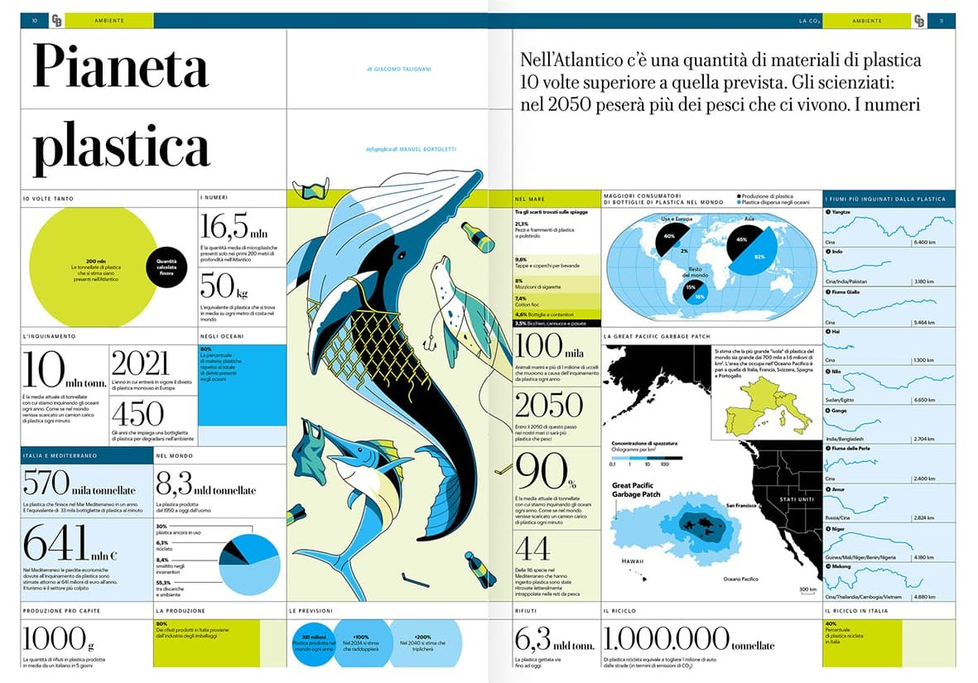
Effect of imagery

Slide 14
Conclusions
Visual working memory has a capacity of between one and three objects depending on their complexity
When we are thinking with the aid of a graphic image we are constantly picking up a chunk of information, holding it in working memory, formulating queries, and then relating what is held to a new information chunk coming in from the display
This means that navigation costs are critical
Putting objects that should be compared close together is essential: we can navigate with eye movements at least ten times faster than we can switch pages

